Slide 1
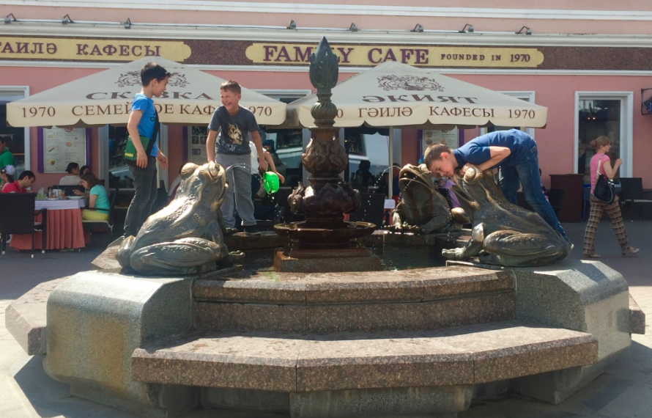
Cities4Kids: Global policies, practices and outlook
Children playing at a water fountain in the city centre of Kazan, Russia.
Photo by Shipra Narang Suri
Dr. Shipra Narang Suri
Vice-President, International Society for City and Regional Planners (ISOCARP)
03 February 2017, New Delhi

Slide 2
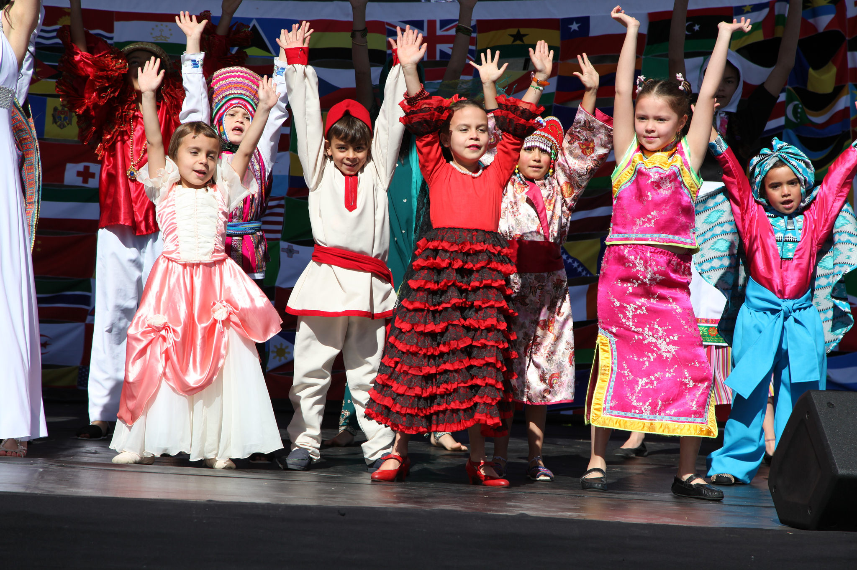
Children in current global policy
Sendai Framework
SDGs
Paris Agreement
World Humanitarian Summit
New Urban Agenda

Slide 3
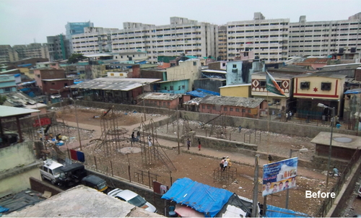
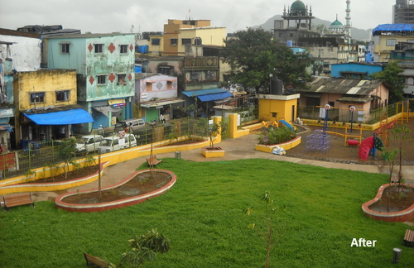
Good practices and innovations
Child Friendly Spaces after disaster (Nepal)
Block by Block (India)
Training young people on Cultures of Peace/ conflict analysis (Lebanon)
Good schools, Good neighbourhoods (Kenya)

Slide 4
Rethinking organizational narratives
UNICEF: Child Friendly Cities
UN-Habitat: Safer Cities
UN Women: Safe Cities Global Initiative
World Vision: Just Cities for Children
Notes:
Why should child-focused organisations be working in urban areas?
Urbanisation is one of the “mega trends” of our time
Over 50% of world population living in towns and cities
Locus of poverty shifting to urban areas
Over 50% of the world’s refugees are in urban areas (not camps)
Conflict, natural disasters, migration, poverty combine to create complex urban crises
Children are particularly vulnerable in these contexts

Slide 5
What is so different about working in urban areas?
Density and Diversity – population, economic activities, services and infrastructure
Complexity – governance system (including institutions, actors and relationships between them)
Scale and Scope of intervention – due to the above factors, the scale of intervention (and impact) can be significant, but the scope may be circumscribed
Notes:
Urban areas are not a ‘tabula rasa’- all interventions must build on what exists already

Slide 6
Planning Cities4Kids
Elements
Housing
Food security
Basic services
Mobility
Public space
Qualities
Safety
Accessibility
Affordability
Environmental quality
Resilience

Slide 7
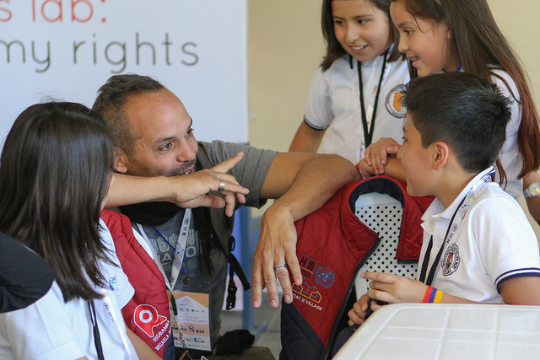
Emerging pathways
Engaging children in:
Policy-making, planning
Prioritization, budgeting
Mobilization, advocacy
Monitoring, reporting

Slide 8
ThanK YOU

